Slide 1
STOR 455 Class 28

Slide 2
Checking Linearity
Three methods depending on the type of dataset:
Datasets with a binary predictor – nothing to check!
Datasets with a quantitative predictor with many response values for each predictor
Datasets with a quantitative predictor with many values for the predictor but few response values for each predictor value.

Slide 3
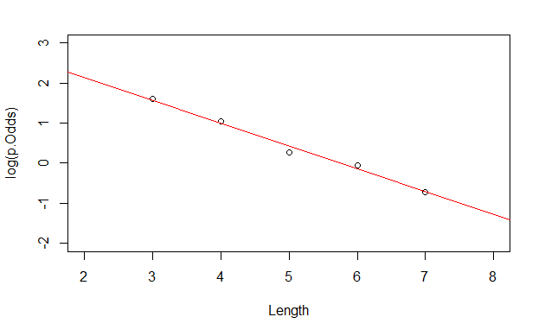
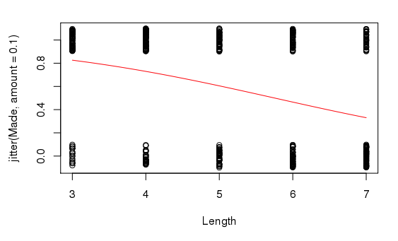
Example: Golf Putts
$$\log\left(\hat{odds}\right)=3.257−0.566∙Length$$
Linear part of logistic fit

Slide 4
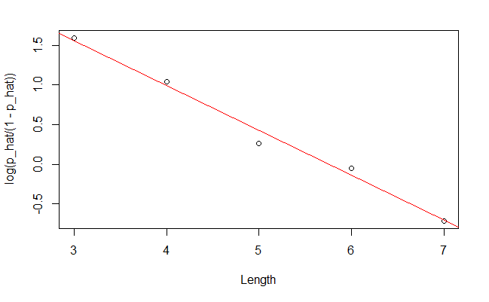
Quantitative predictor:
Many response values for each predictor
Does the data appear linear?

Slide 5
Checking Linearity
Three methods depending on the type of dataset:
Datasets with a binary predictor – nothing to check!
Datasets with a quantitative predictor with many response values for each predictor
Datasets with a quantitative predictor with many values for the predictor but few response values for each predictor value.

Slide 6

Golden Balls
A popular British TV show called Golden Balls features a round where two contestants each make a decision to either split or steal a large amount of money. If both choose “split,” they share the prize evenly, but if one chooses “split” and the other picks “steal,” the whole prize goes to the player who steals. If both choose “steal,” they both win nothing.

Slide 7

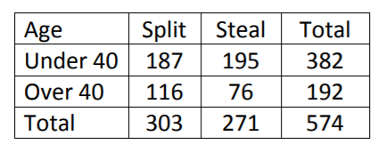
Golden Balls
Claim: There is a difference in the proportion of people who would split or steal based on their age.

Slide 8
Golden Balls: Logistic Regression
GBmod = glm(Split~Over40, data=GoldenBalls, family=binomial)
summary(GBmod)
Coefficients:
Estimate Std. Error z value Pr(>|z|)
(Intercept) -0.04189 0.10235 -0.409 0.68233
Over40 0.46475 0.17960 2.588 0.00966 **
---
Signif. codes: 0 ‘***’ 0.001 ‘**’ 0.01 ‘*’ 0.05 ‘.’ 0.1 ‘ ’ 1
(Dispersion parameter for binomial family taken to be 1)
Null deviance: 793.95 on 573 degrees of freedom
Residual deviance: 787.17 on 572 degrees of freedom

Slide 9
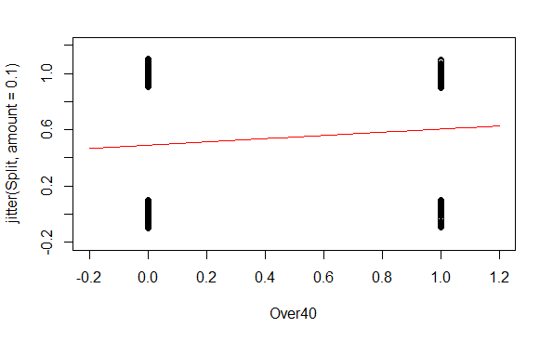
Golden Balls: Logistic Regression
GBmod = glm(Split~Over40, data=GoldenBalls, family=binomial)
B0 = summary(GBmod)$coef[1]
B1 = summary(GBmod)$coef[2]
plot(jitter(Split,amount=0.1)~Over40,data=GoldenBalls,
xlim=c(-.2, 1.2), ylim=c(-.2, 1.2))
curve(logit(B0, B1, x),add=TRUE, col="red")

Slide 10
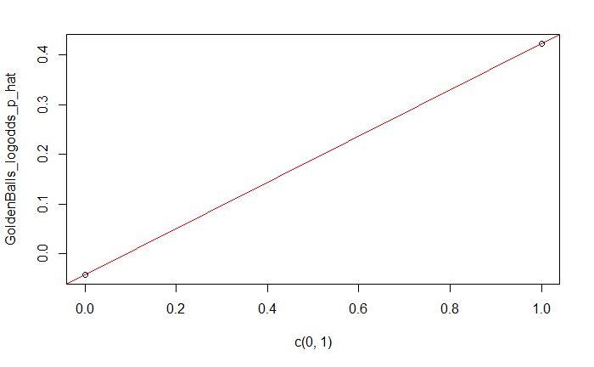
Golden Balls: Logistic Regression
GoldenBalls_table = table(GoldenBalls$Split, GoldenBalls$Over40)
GoldenBalls_p_hat = as.vector(GoldenBalls_table[2,]/colSums(GoldenBalls_table))
GoldenBalls_logodds_p_hat = log(GoldenBalls_p_hat/(1-GoldenBalls_p_hat))
plot(GoldenBalls_logodds_p_hat~c(0,1))
abline(B0, B1, col="red")
Does the data appear linear?

Slide 11
Checking Linearity
Three methods depending on the type of dataset:
Datasets with a binary predictor – nothing to check! We’ll come back to this…
Datasets with a quantitative predictor with many response values for each predictor
Datasets with a quantitative predictor with many values for the predictor but few response values for each predictor value.

Slide 12
Quantitative predictor:
Few response values for each predictor
This process breaks down if there are not many values of the response, but the previous process can be mimicked by manipulating the data first.
We can manipulate the data by:
Slicing the x-axis into intervals.
Compute the average x-value and empirical logit for each slice
Plot the values as before

Slide 13
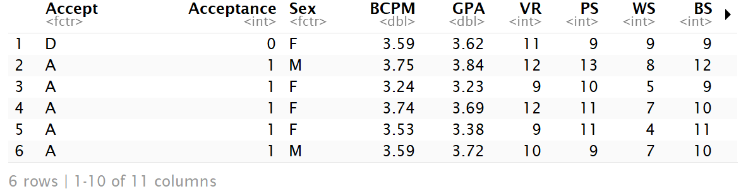
Quantitative predictor:
Few response values for each predictor
Medical School Acceptance Dataset:
Is GPA a useful predictor for acceptance to medical school?
data("MedGPA")
head(MedGPA)

Slide 14
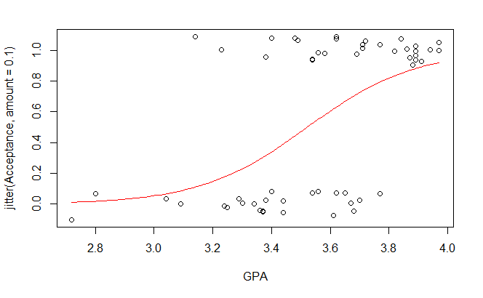
Quantitative predictor:
Few response values for each predictor
MedGPA.glm = glm(Acceptance~GPA, data=MedGPA, family = binomial)
plot(Acceptance~GPA, data=MedGPA)
B0 = summary(MedGPA.glm)$coef[1]
B1 = summary(MedGPA.glm)$coef[2]
plot(jitter(Acceptance,amount=0.1)~GPA,data=MedGPA)
curve(logit(B0,B1,x),add=TRUE, col="red")

Slide 15
Quantitative predictor:
Few response values for each predictor
Create a new dataframe with the predictor sorted smallest to largest
sorted.MedGPA = MedGPA[order(MedGPA$GPA),]
GPA = sorted.MedGPA$GPA
Acceptance = sorted.MedGPA$Acceptance

Slide 16
Quantitative predictor:
Few response values for each predictor
groups = 5
group.size = 11
GPA.means = 0
for(i in 1:groups){
GPA.means[i] = mean(GPA[((group.size*i)-(group.size-1)):(group.size*i)])
}
Select a number of “slices” or groups for the data and find the mean value of the predictor for each slice

Slide 17
Quantitative predictor:
Few response values for each predictor
Acceptance.sums = 0
for(i in 1:groups){
Acceptance.sums[i] = sum(Acceptance[((group.size*i)-(group.size- 1)):(group.size*i)])
}
Find the number of acceptances for each slice

Slide 18
Quantitative predictor:
Few response values for each predictor
Acceptance.prop.adj = (Acceptance.sums +0.5)/(group.size+1)
logodd.Acceptance.adj = log(Acceptance.prop.adj/(1-Acceptance.prop.adj))
“Fudge” the proportions slightly and find the log of the predicted odds
Why “fudge”?
Proportions of 0 and 1 cause issues.

Slide 19
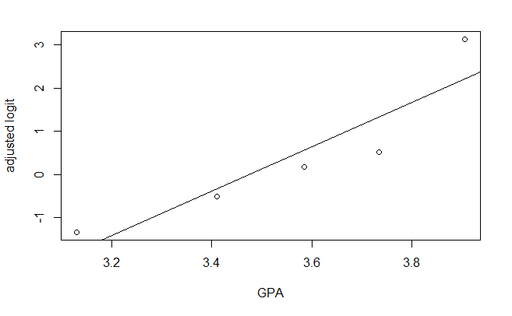
Quantitative predictor:
Few response values for each predictor
Plot the logodds of the adjusted proportions by the means of the predictor variables and a linear model
plot(logodd.Acceptance.adj~GPA.means)
abline(B0,B1)
Does the data appear linear?
Do the number of groups matter?

Slide 20
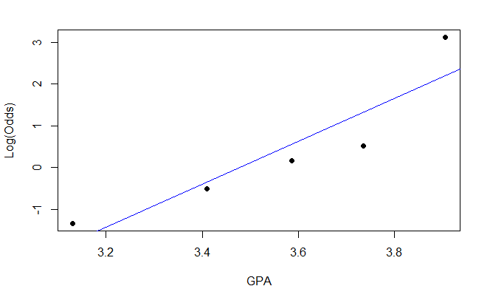
Quantitative predictor:
Few response values for each predictor
emplogitplot1(Acceptance~GPA, data=MedGPA, ngroups=5)
Does the data appear linear?
Do the number of groups matter?

Slide 21
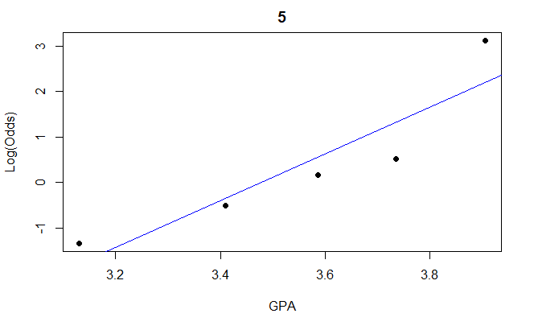
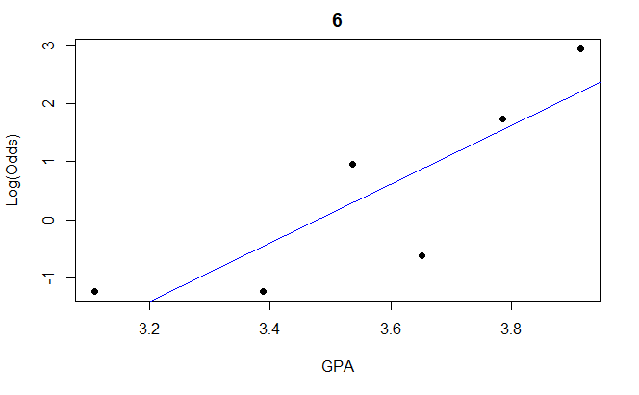
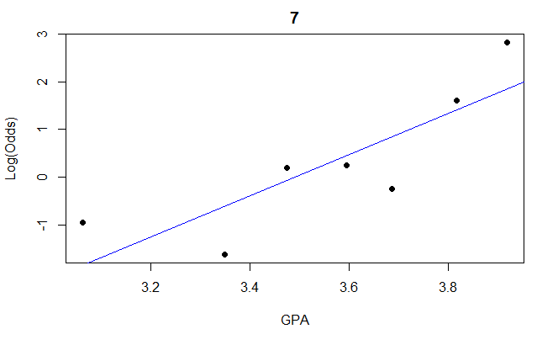
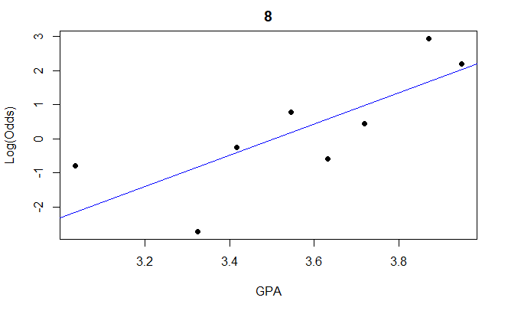
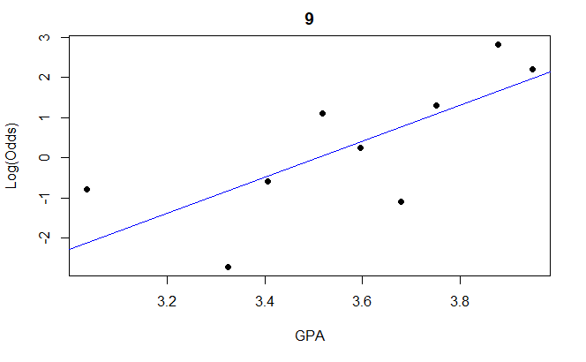
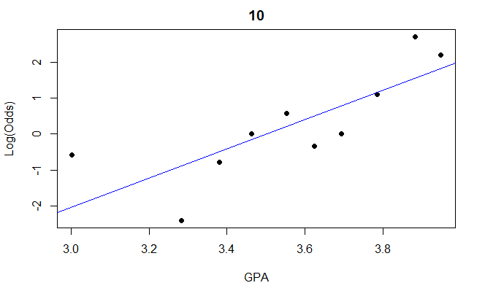
Quantitative predictor:
Few response values for each predictor
for(j in 5:11){emplogitplot1(Acceptance~GPA, data=MedGPA, ngroups=j, main=j)}
Does the data appear linear?

Slide 22
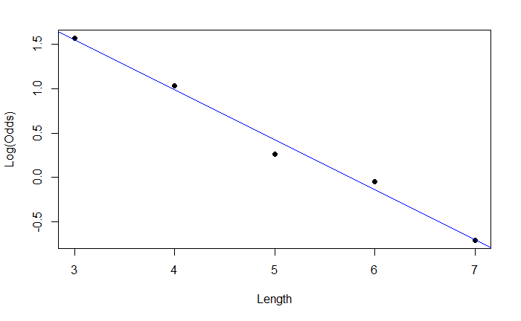
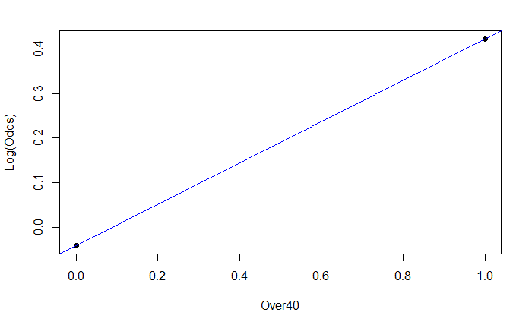
data("Putts1")
emplogitplot1(Made~Length, data=Putts1, ngroups="all")
emplogitplot1(Split~Over40, data=GoldenBalls, ngroups="all")

